Slide 1
Underneath the Arches
The Architecture of St Hilda’s Church in its context
In the course of a visit earlier this year by some of the Friends of Durham Cathedral to Bath & Wells, it struck me that Wells was built only a little before St Hilda’s - and I began to look for similarities in the architecture. A short time later, at the Friends’ festival in Durham, I went on a tour, led by the architect, concerned with the development of Romanesque architecture within the cathedral. My enthusiasm was aroused!
This summer, the Friends were asked, as part of the cathedral’s Foundation 2020 campaign, to take part in an associated appeal - A Moment in Time - by raising £100, the sum required to cover a minute’s overall maintenance costs for the upkeep of the cathedral.
The suggestion of making and selling 100 cakes was a non-starter for me! Instead, I decided to offer this short presentation designed to show how the architecture of St Hilda’s relates to the developing pattern of architecture elsewhere.
I am grateful to the members of St Hilda’s congregation whose sponsorship enabled me to exceed the specified target appreciably.
At the outset, I commend to you two excellent publications:-
DURHAM World Heritage Site, obtainable from the site office in Owengate on the way up to the cathedral and
DURHAM CATHEDRAL The Shrine of St Cuthbert, which is available in the cathedral bookshop.
Incidentally, I’m sure that if William the Conqueror had read that title, he would have smiled and said “It was a good idea, wasn’t it!”
My specific thanks are due to Ian Pounder, our organist at St Hilda’s, who transformed my text and slides into the presentation which you are about to see.
John Hogg
September 2019

Slide 2
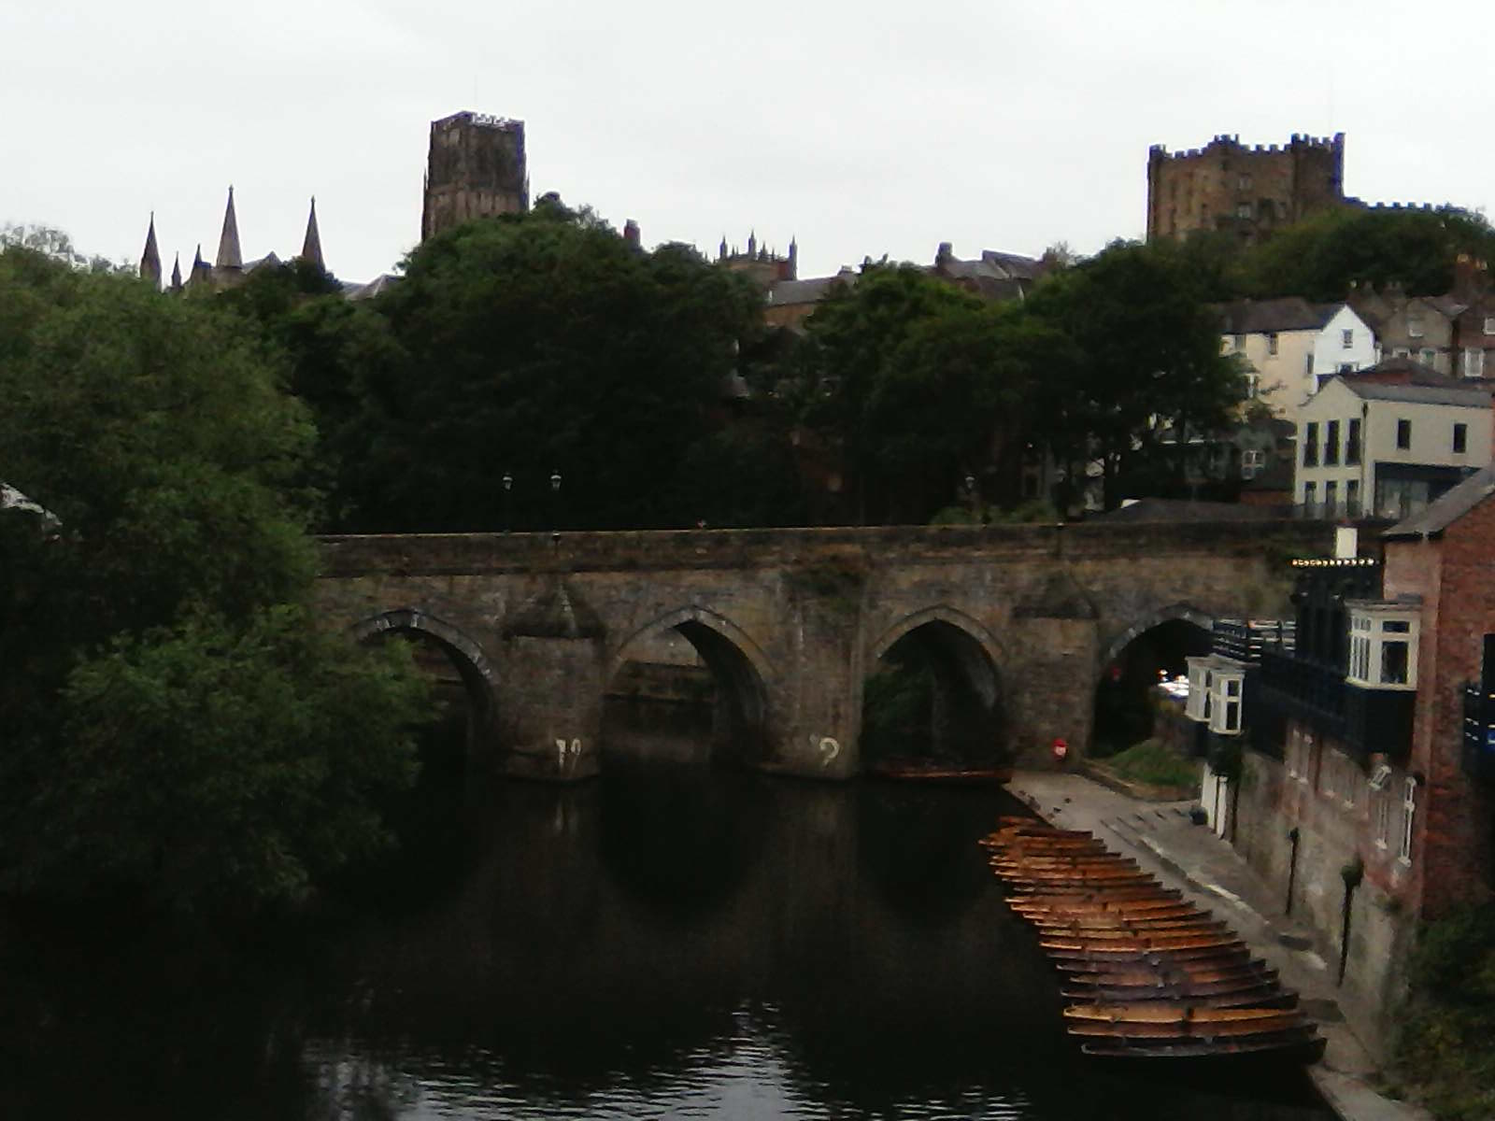
1 The Cathedral & Castle
Though St Cuthbert had died on Lindisfarne on 20 March 687, it was only after some amazing journeyings that his body arrived in Durham in 995, where the monks who accompanied it built a small church and a shrine.
After his conquest of England in 1066, William I chose Durham as his base from which to administer the north of his kingdom and to protect it against invasion by the raiding Scots. It was a prudent choice - the church was situated in a good defensive position, encircled on three sides by the river and had already become a popular pilgrimage site. He therefore ordered the building of a castle, monastery and a cathedral for the shrine of St Cuthbert

Slide 3
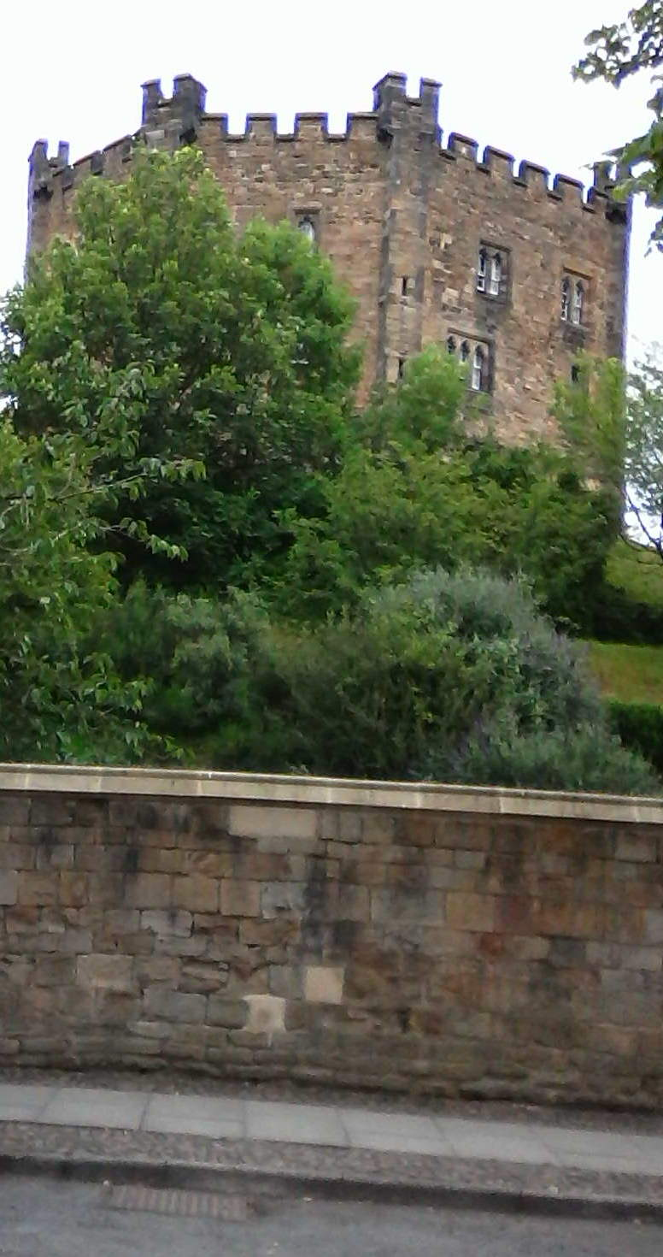
2 The Castle
Built in 1072, the Norman chapel of the castle, on the north side of Palace Green, is Durham’s oldest building. This is the keep.

Slide 4
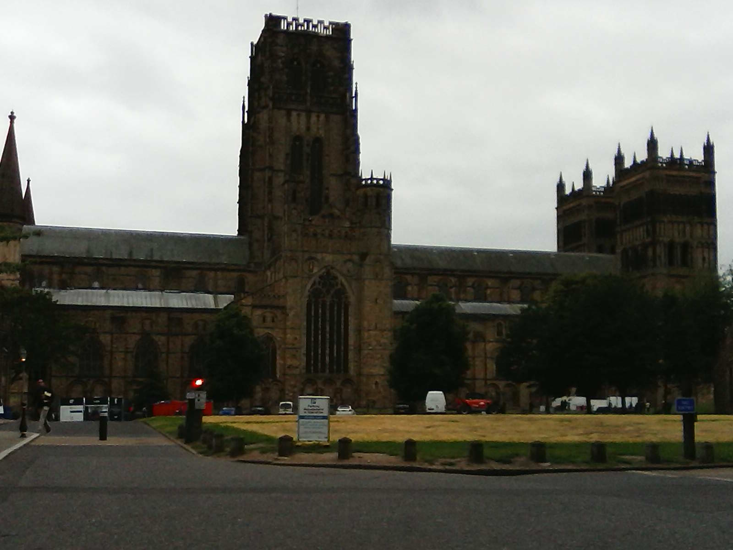
3 The Cathedral
On the south side of Palace Green is the massive cathedral which was built in 40 years between 1093 and 1133. Although building continued into the 13th century, the interior of the cathedral we see today is Norman in style.

Slide 5
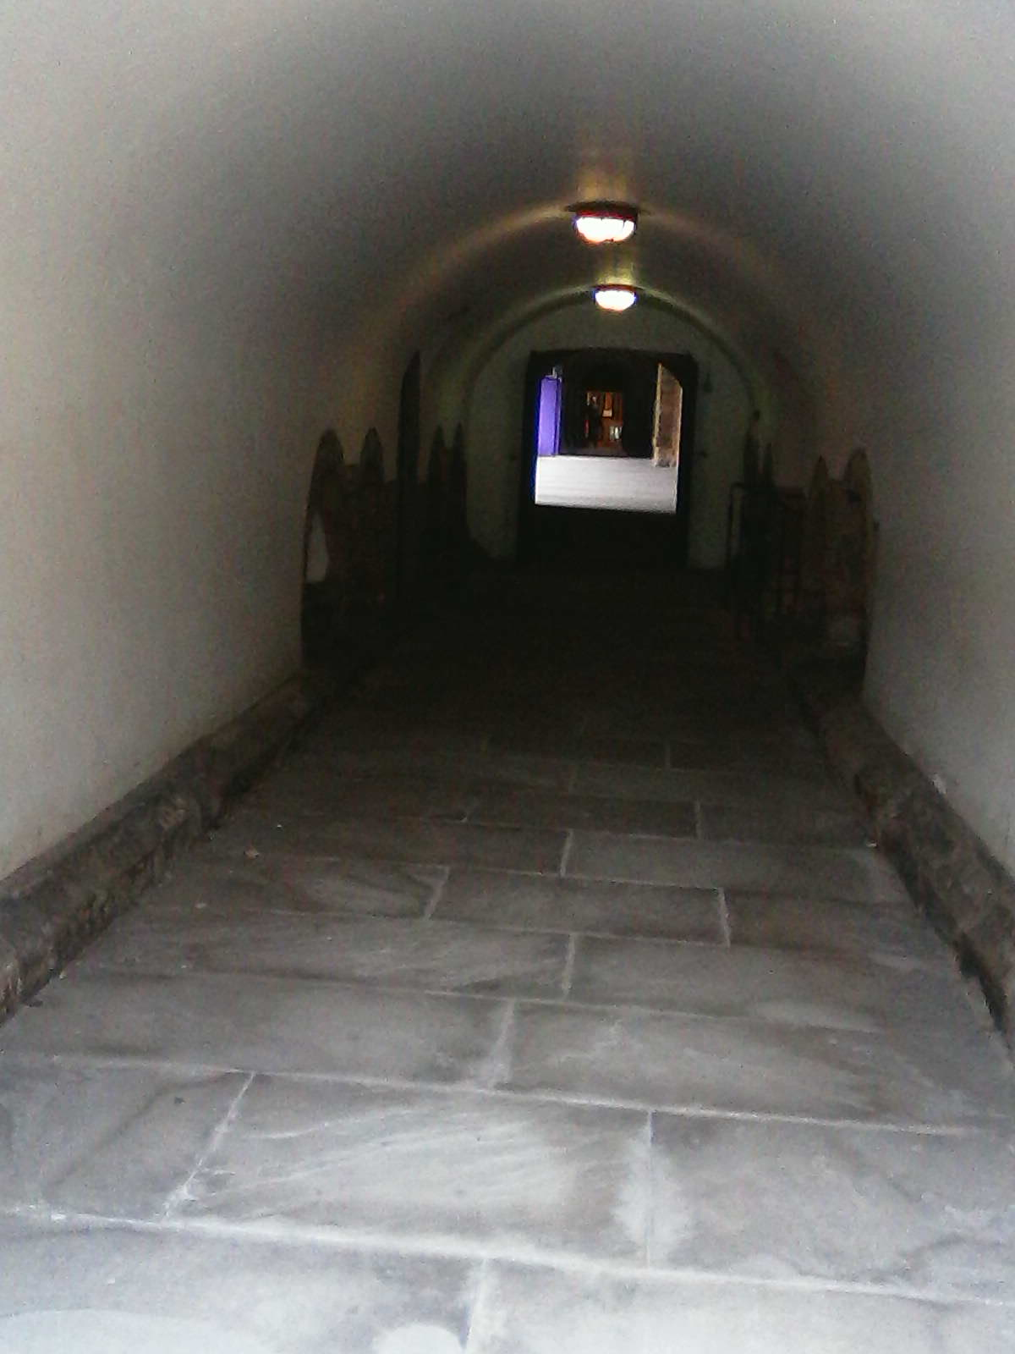
4 Entrance from the College
We enter the cathedral complex on its south side by the door beside the Deanery through a round-roofed passage which leads to the north side of the cloisters.

Slide 6
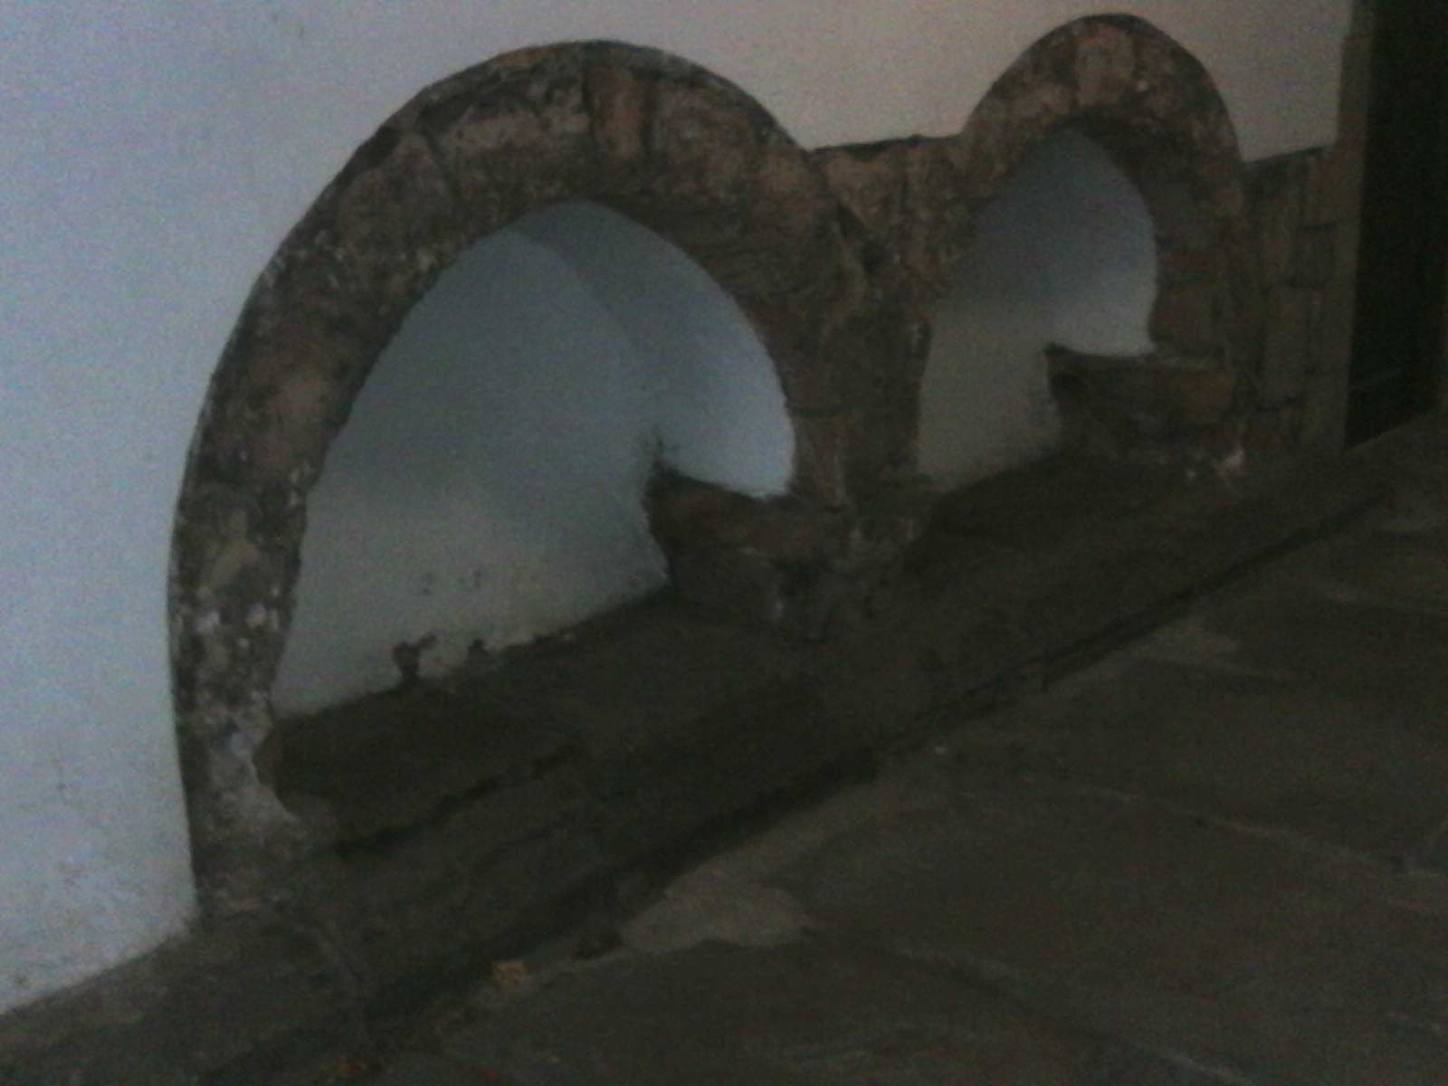
5 Small Norman arches
Notice, on the sides, some arches, which, though small, have the distinctive semi-circular shape of their Norman origin.

Slide 7
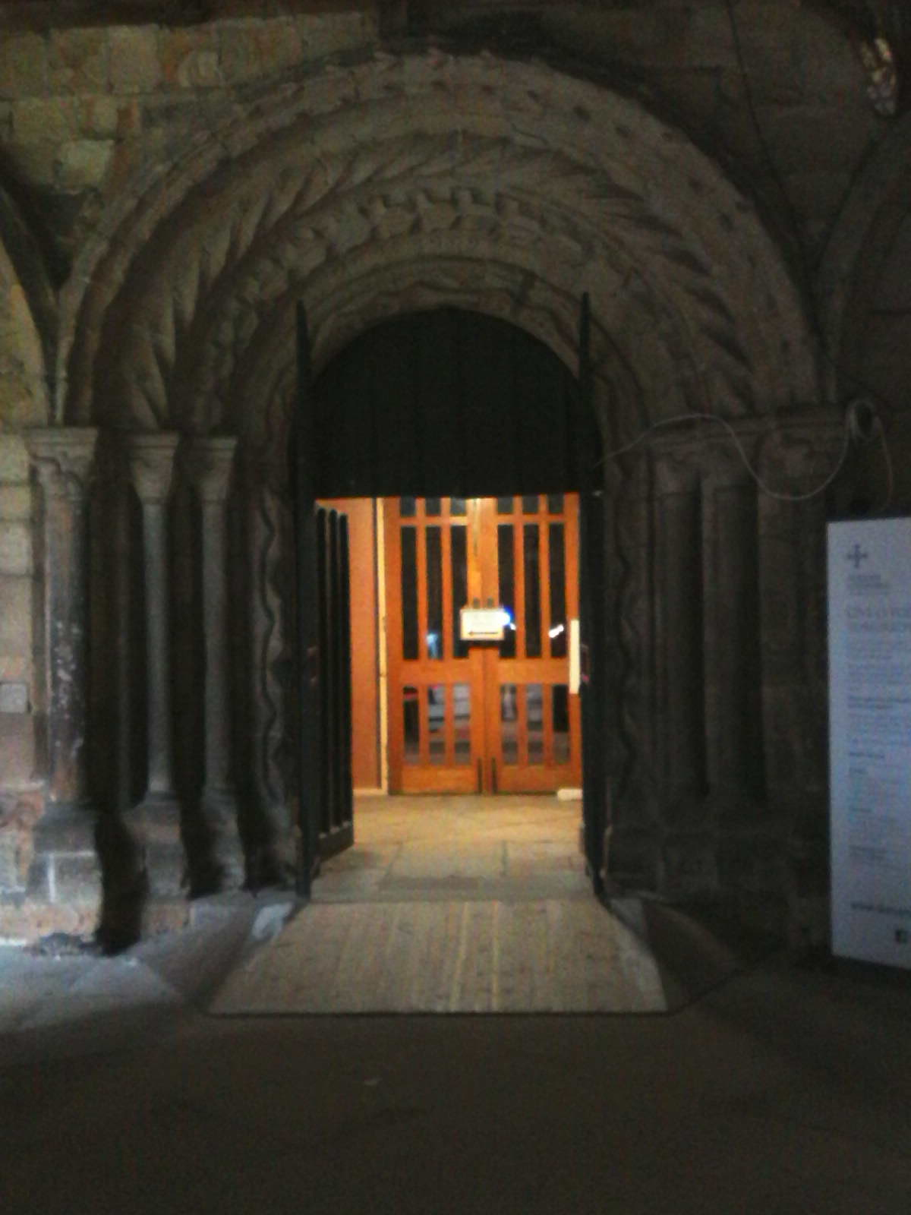
6 Elaborate Norman arch
At the end of the cloisters we enter the cathedral itself through this highly elaborate Norman arch.

Slide 8
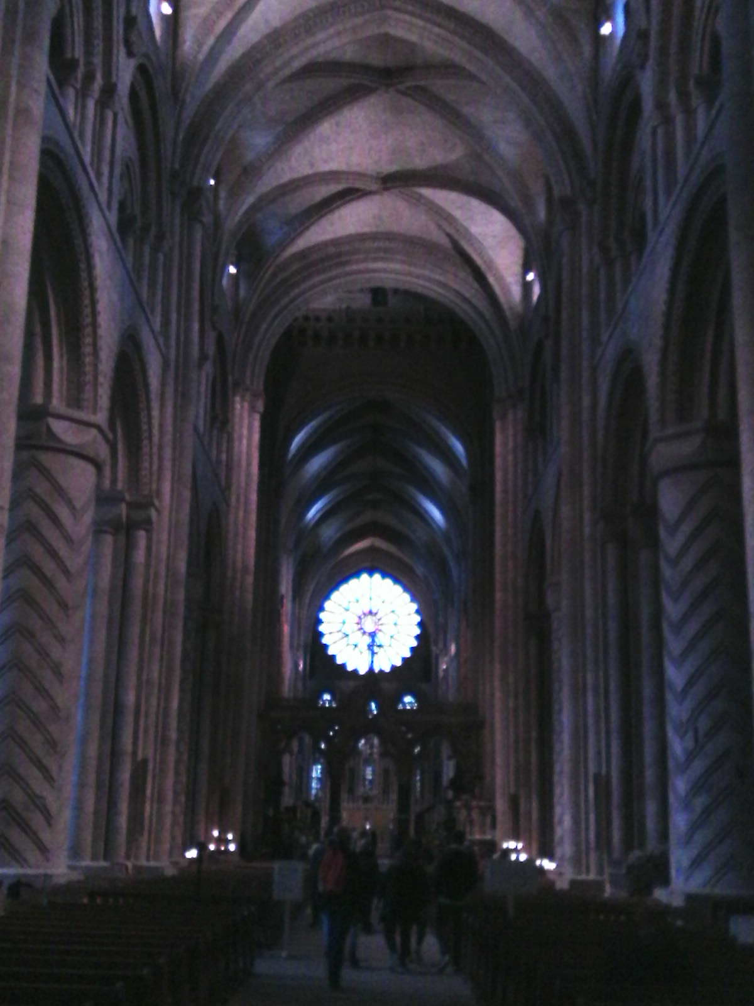
7 The Nave
Looking down the nave eastwards from the font towards the altar, we see distinctively-decorated columns which support semi-circular Norman arches. Above them, however, the stone roof is supported by ribbed pointed arches. This was innovatory work and is the earliest surviving stone vault of such size in the world.
For more information about this remarkable building, see Sue Dobson, The 50 Greatest Churches and Cathedrals of the World, Icon Books Ltd., 2017.

Slide 9
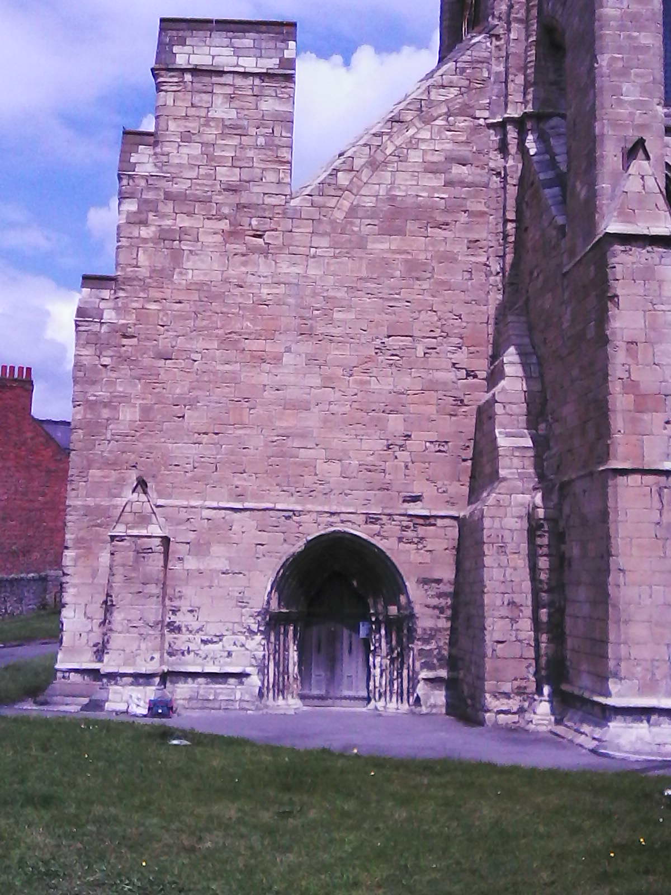
8 Hartlepool St Hilda : south tower door
We now come to our own church which was begun in 1192 - 99 years after Durham Cathedral - and enter through one of the buttresses which were built during the first century of the church’s life to help to secure the tower, as the land beneath it was found to be relatively unstable and prone to cracking.

Slide 10
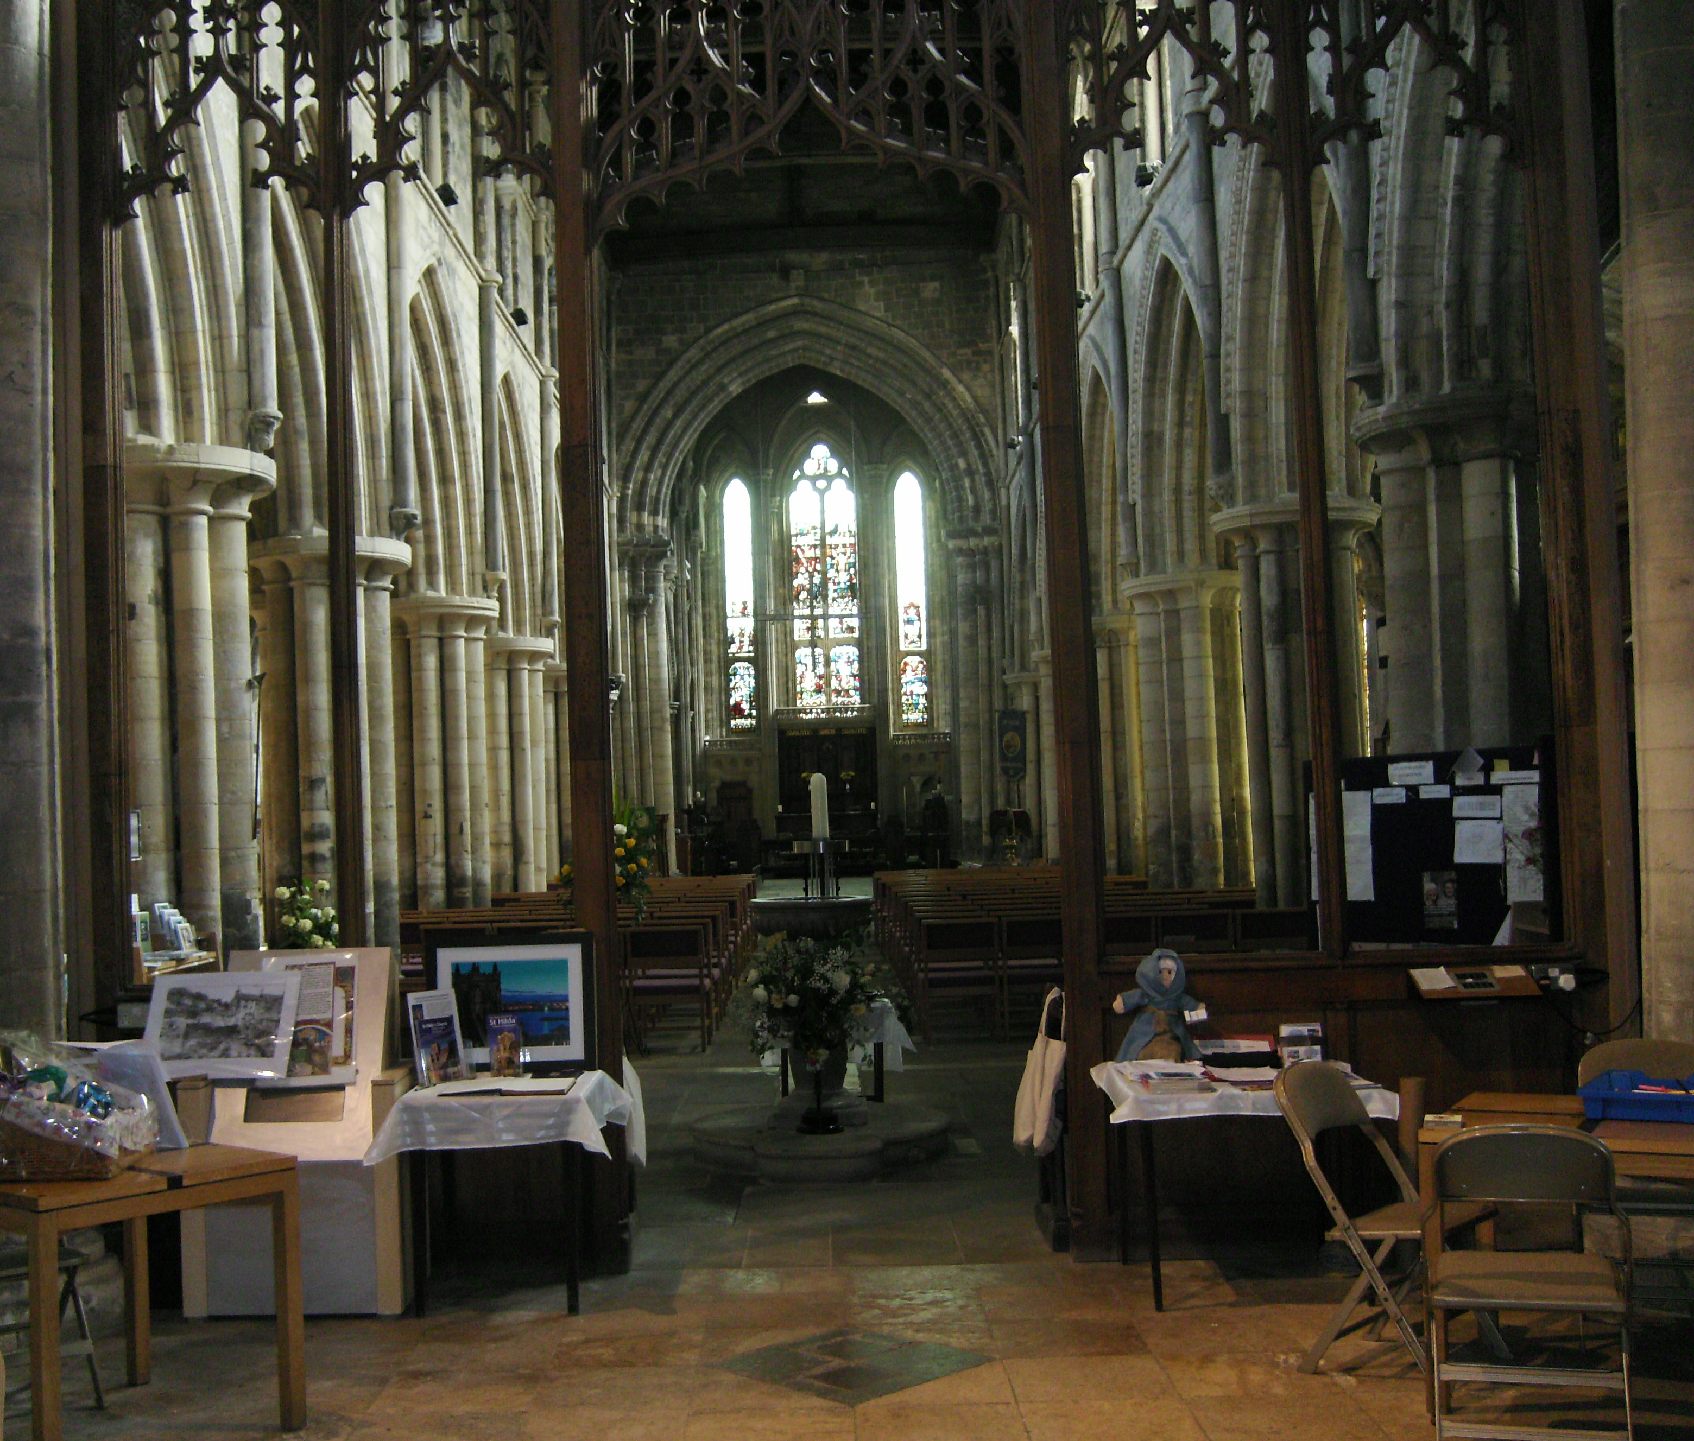
9 The nave
Whereas Durham Cathedral had round Norman arches in the nave, at St Hilda’s, begun practically a century later, here we have the pointed Early English arches pioneered at Durham. Notice the wooden roof.

Slide 11
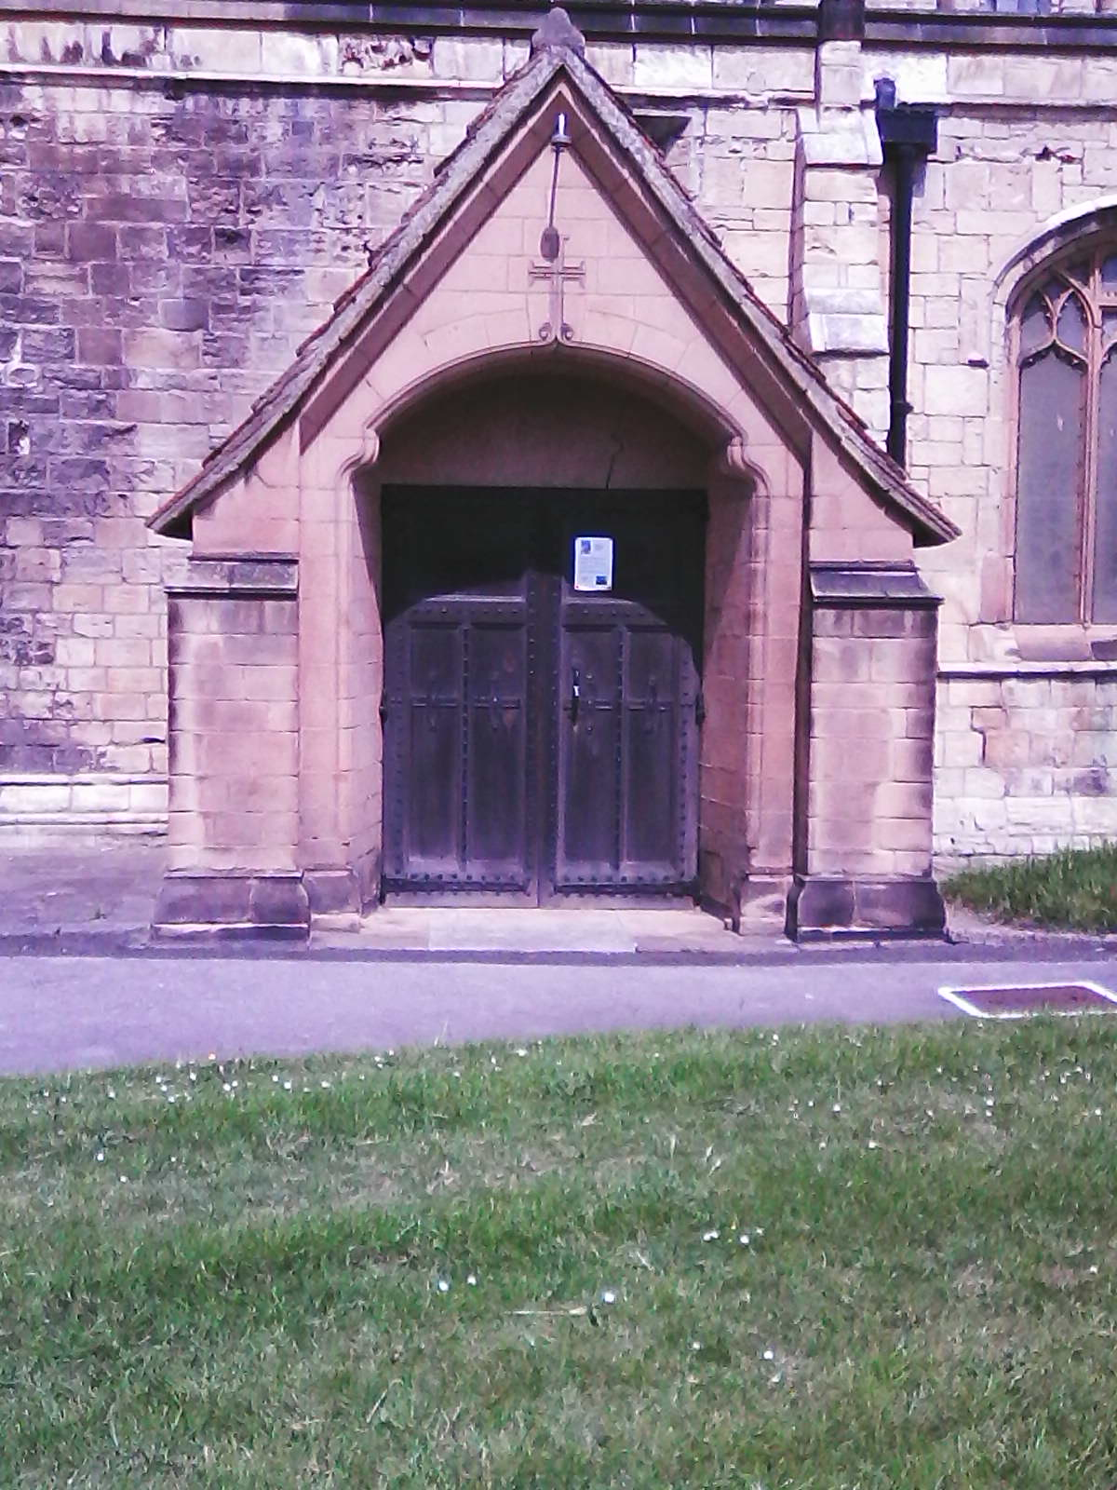
10 South Porch
Now it’s time to go out of the church and enter it again via the South Porch.

Slide 12
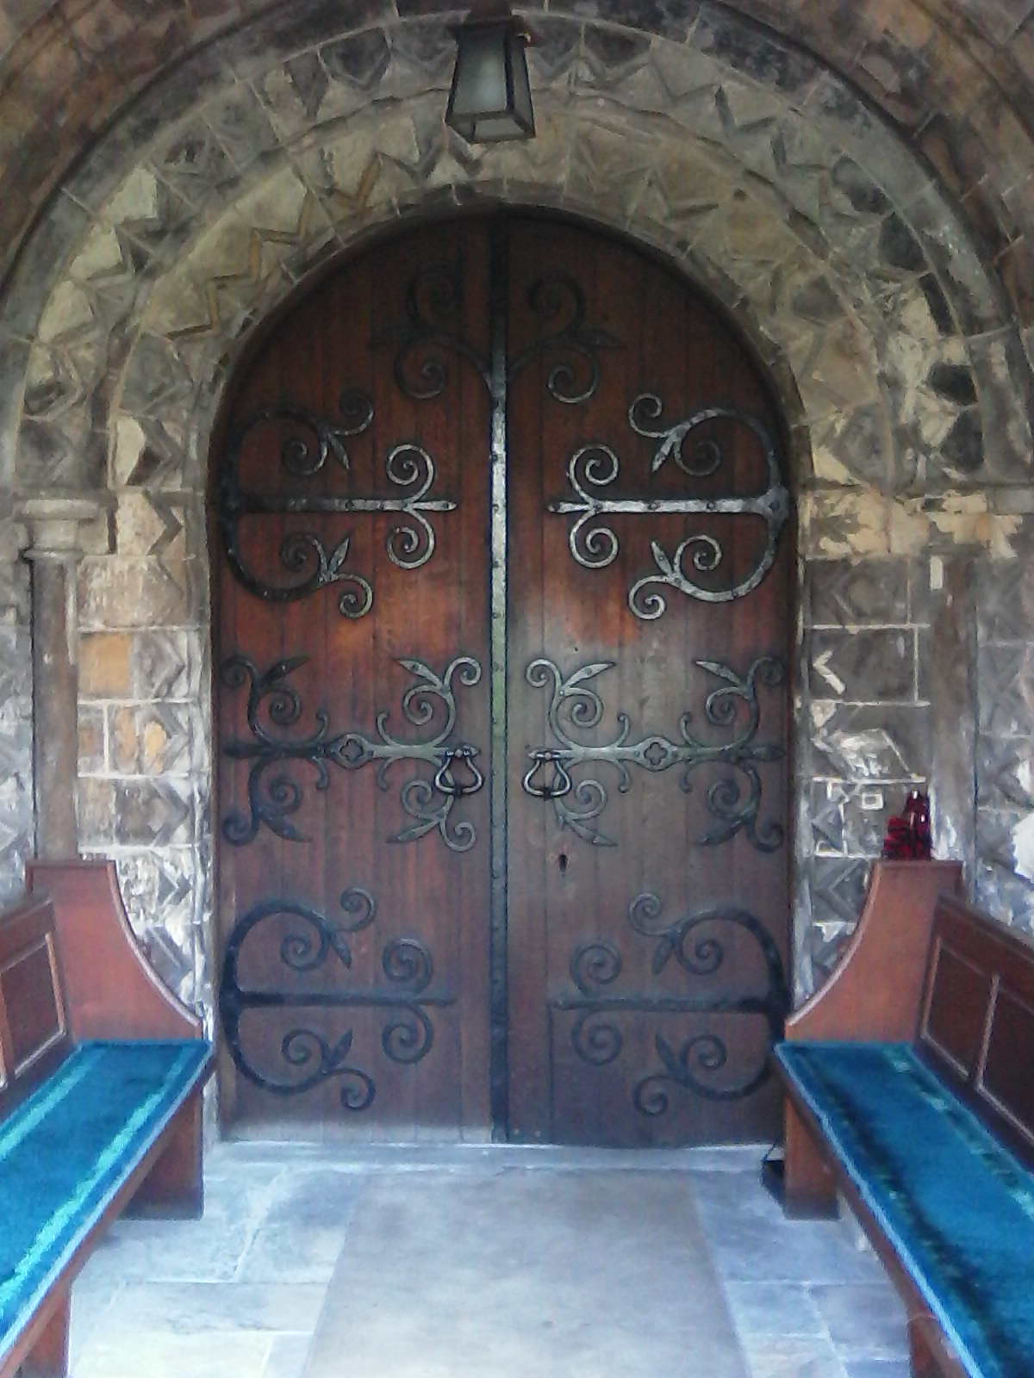
11 South Porch - the Norman Arch
What is this Norman arch doing here?
a) Tees Archaeology explain that it was built about 50 years before the present St Hilda’s church, as part of an earlier building but that when this church was being built, this arch was “recycled” into it from its previous position - though we don’t know exactly where that was.
b) It does seem, though, that even in the C12th, these earlier-style arches were still being built, particularly for entrances to buildings.

Slide 13
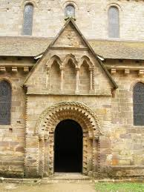
12 Brinkburn Priory, Northumberland
For example, the north door of Brinkburn Priory in Northumberland, which was built between 1190 and 1220 - about the same time as St Hilda’s - has a Norman Arch but above it is an arcade in the contemporary Early English style.

Slide 14
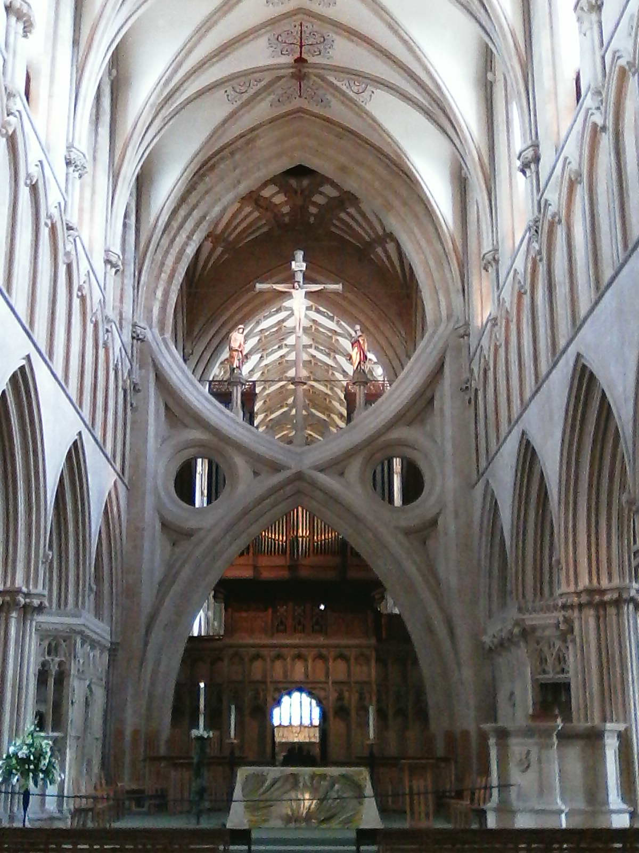
13 Wells Cathedral
We now go south-west to Wells Cathedral in Somerset, upon which building began in 1175, some 17 years before St Hilda’s but 82 years after Durham Cathedral. Notice that the nave arches are in the Early English pointed style.
Notice the distinctive the scissor arch in front of the chancel screen. Actually it’s one of three - the others are to the north and south - they’re all to do with the tower problem again.
In 1313 the tower had been heightened and a lead-covered spire placed on top. After cracks had begun to appear in the cathedral walls and other solutions seemed not to be effective, these scissor arches were built, as a final solution, between 1338 and 1348 - a remarkable achievement. [Apparently, according to contemporary thinking, the problem was solved, not by the construction of these arches but by other work done on e.g. windows - much as W D Caroe did here in the 1925 - 1932 restoration.]

Slide 15
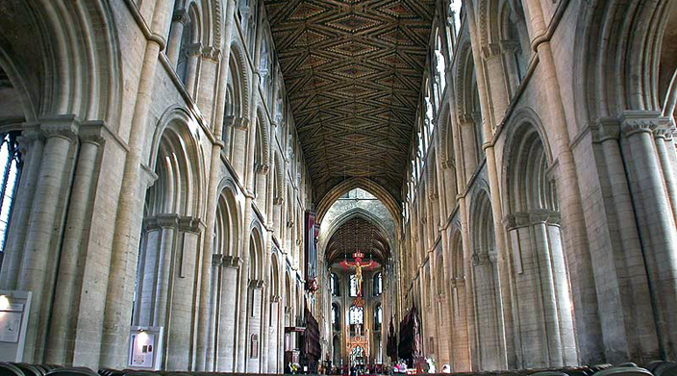
14 Peterborough Cathedral
Begun in 1118, only 15 years after Durham but 74 years before St Hilda’s, the arches of the nave are in the Norman style. The structure of the building remains essentially as it was on completion.
Notice, though, that whereas Durham has a stone roof, Peterborough’s is wooden - less imaginative, perhaps - but that original wooden ceiling is still in place, the only one of its type in this country and one of only four wooden ceilings of this period surviving in the whole of Europe. It’s been over-painted twice but retains its original style and pattern.
When I was there in 2015, I suddenly began to feel that I was at home because:
- from the back of the nave there was a full-length, uninterrupted view down the building
- above the altar there was a hanging cross

Slide 16
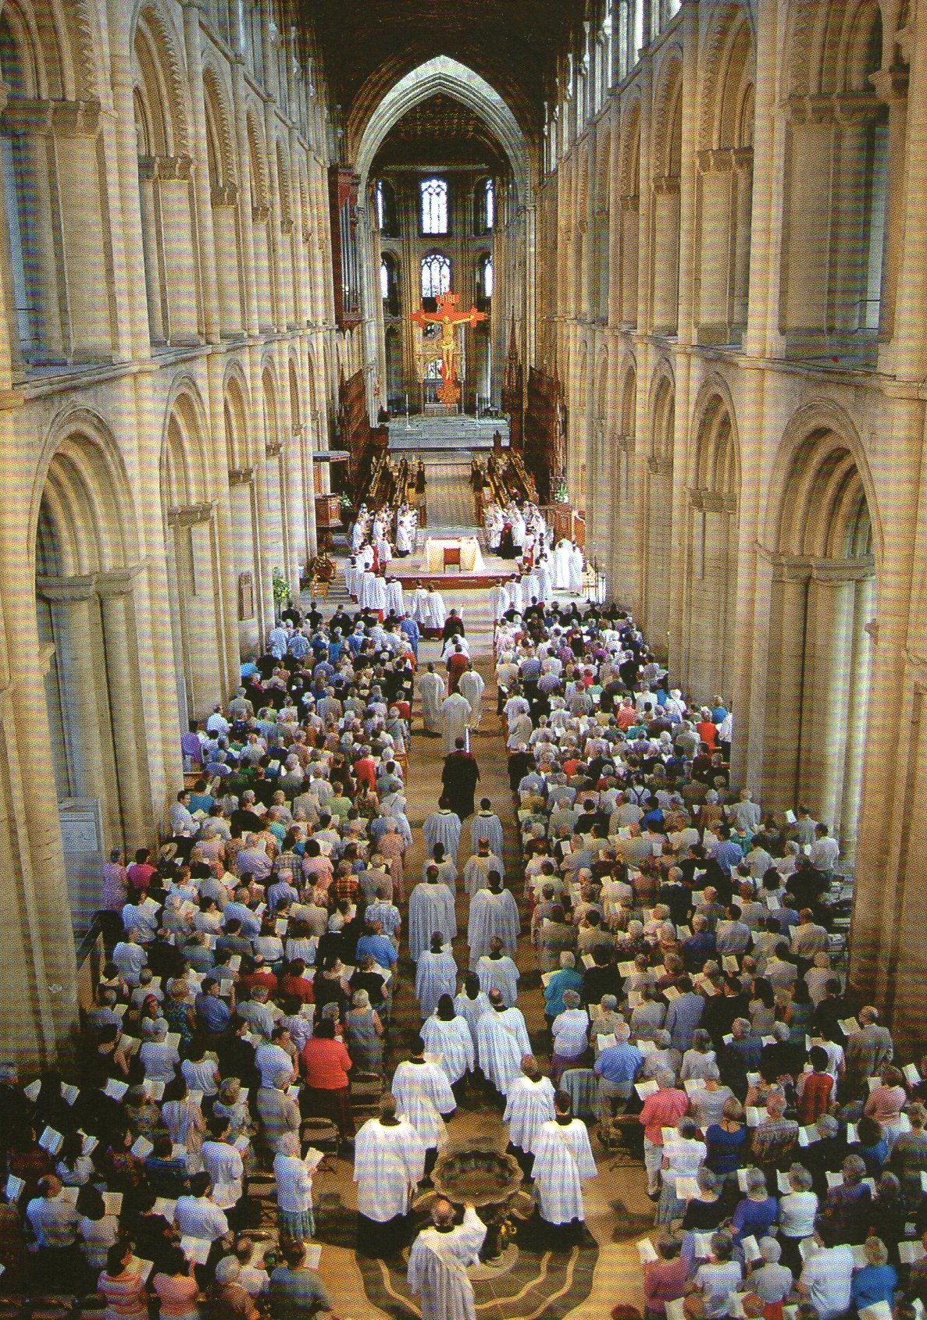
15 Ordination Day at Peterborough
This slide, enlarged from a postcard, shows these features more clearly.

Slide 17
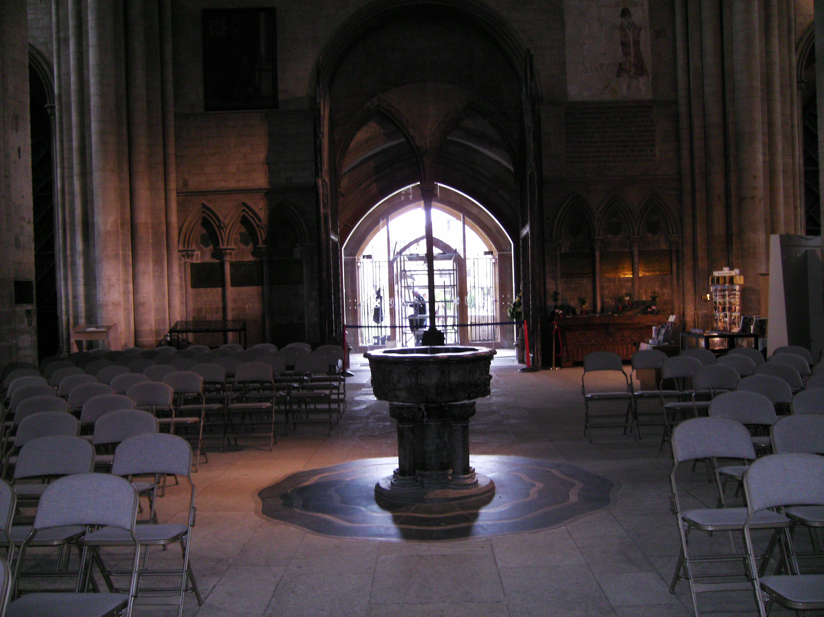
16 Peterborough Cathedral : west end
… but when I turned, I felt even more at home because I saw:-
- the font
- some familiar chairs!
- and wooden doors but opened to show a pair of glass doors giving a view into the porch outside - something which we hope that we may see here one day.
Further developments in the history of St Hilda’s Church
- In 1724 much of the chancel was demolished as being unsafe but in 1870 part of it was rebuilt. Between 1925 and 1932 considerably more work was done on the church, including measures to stabilise the tower, and the completion of the chancel.
- At Easter 2004 the Visitor Centre, recently incorporated into the church, was opened.
Information and illustrations relating to these events can be seen at various points in the church. Please take a guide leaflet and enjoy your visit.

